Slide 1


Location Analytics
Final Presentation
Pranav Sachdev
Mir Akram Ali Yadullahi
Siva Rama Krishna Kottapalli
Team-8

Slide 2
Agenda
Introduction
Objective
Process Flow
Approach
Data Cleaning
Descriptive Data Analysis
Text Mining
Geocoding
Identifying Local Time
Data Visualization
Insights & Recommendations

Slide 3
Introduction
Stack overflow stores time related data in ‘Coordinated Universal Time’ format.
Becomes difficult to localize the analysis to the user’s specific region.
Highly inconsistent location data.
Example:
Large number of users with location not defined
Inconsistent naming conventions for similar/same locations.
Spelling mistakes in location
Special characters

Slide 4
Objective
Determine the local time of the post based on the user location.
Identify peak active times for each geographical region.
Identify trends in the posting activity based on the local time
Determine the most active geographical hub of a particular technology/tag.

Slide 5
Process Flow
Dataset
Location cleaned
Identified correct location - ‘Geocoder’
Identified timezones - ‘tzwhere’
Identified local time - ‘pytz’& ‘datetime’

Slide 6
Approach
Around 0.8 million users - ‘Location’ defined.
Sampled 86,000 users.
4-phase strategy:
Data Cleaning
Text Mining
Geocoding
Identifying Local Time

Slide 7
Approach - Data
Posts
Users
Tags
Master Data
User Reputation > 100
Posts in year 2015

Slide 8
Data Cleaning

Slide 9
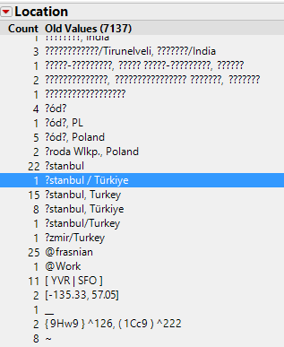
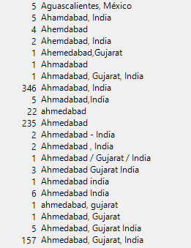
Inconsistencies in data

Slide 10
Approach – Data Cleaning
‘User Location’:
Considered only alphabet, comma and white space.
Removed special characters.
Converted all text into lowercase.
Stripped all the leading and trailing spaces.

Slide 11
Text Mining

Slide 12
Approach - Text Mining
Imported the ‘cleansed’ data in SAS
Applied ‘Text Analytics’ techniques on the ‘Location’ field using ‘SAS Enterprise Miner’.
Each of the user was considered as a ‘Document’ for analysis
Used the ‘Text Parsing’, ‘Text Filter’ and ‘Text Topics’ nodes
Used ‘Entropy’ weight for ‘Term’ Linkages
The results were categorization of related ‘Terms’ into ‘Topics/Concepts’

Slide 13
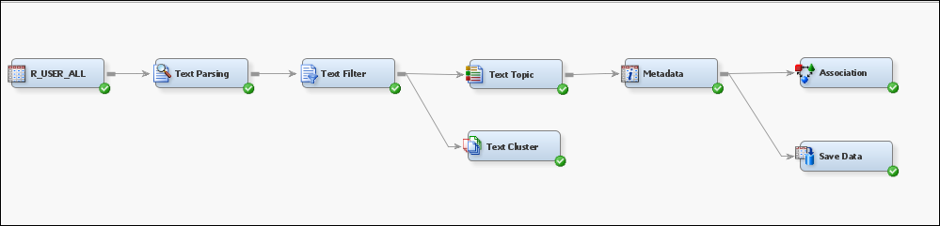
Text Analytics
Process Flow

Slide 14
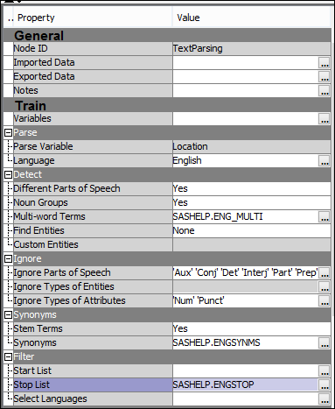
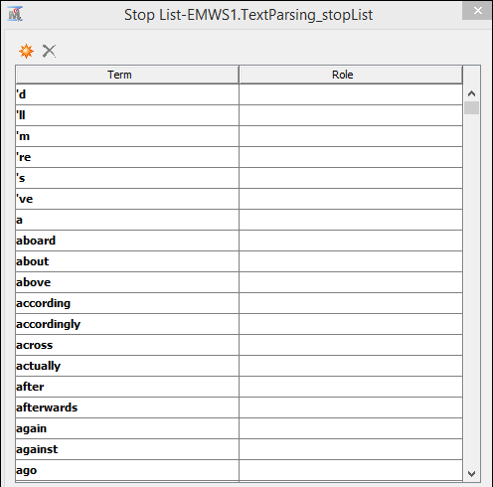
Text Analytics – Text Parsing Node
Sample Stop List

Slide 15
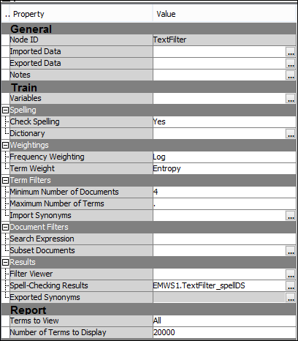
Text Analytics – Text Filter Node

Slide 16
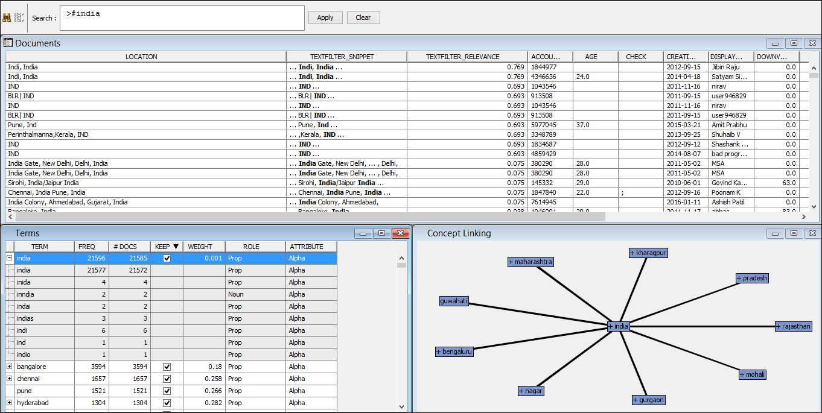
Text Analytics – Text Concept Linkage

Slide 17
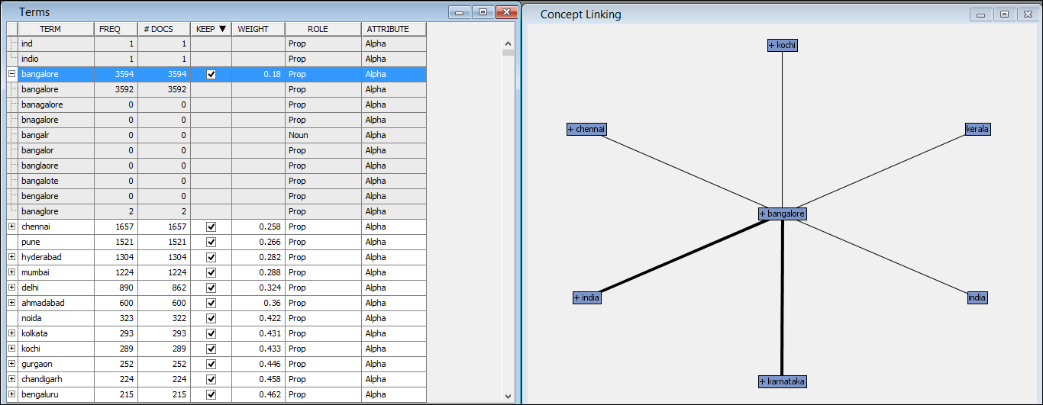
Text Analytics – Text Concept Linkage

Slide 18
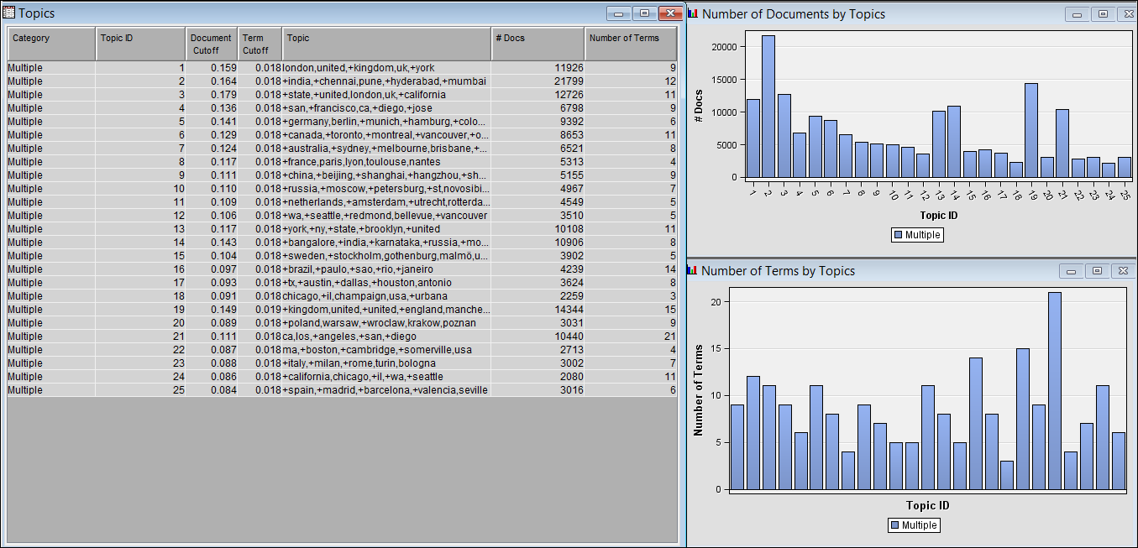
Text Analytics – Text Topics

Slide 19
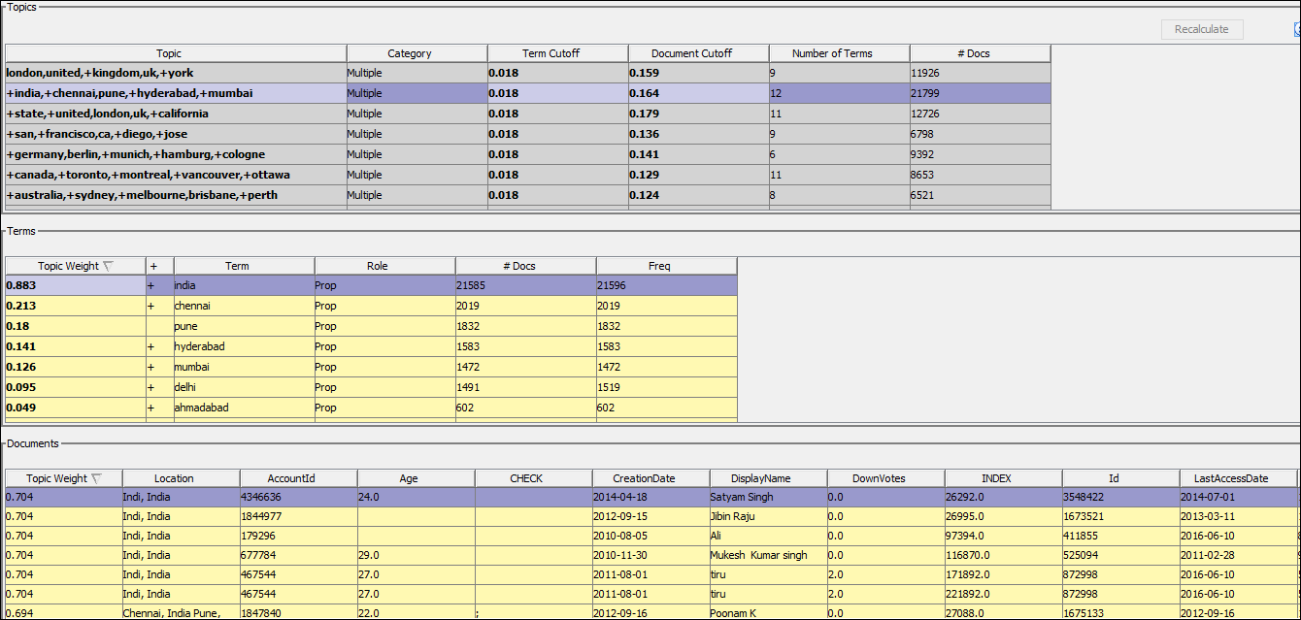
Text Analytics – Text Topics Details

Slide 20
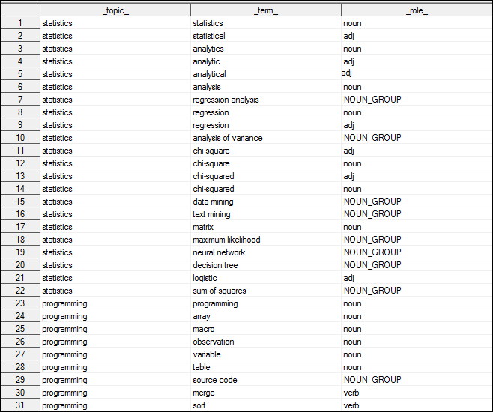
Text Analytics
An approach to ‘supervised learning’ is described here.

Slide 21
Geocoding

Slide 22
Approach – Geocoding
Required to identify user location (latitudes/ longitudes).
Geocoder package in python
Google api – limitation of processing 2500 observations per day.
Bing api
17-hours to process 86,000 observations.
Bing api
User location
‘geocoder’ package
Latitudes/ Longitudes
User Location

Slide 23
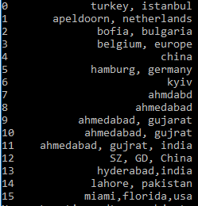
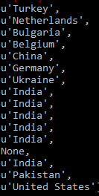
Approach - Geocoding
Unprocessed Data
Processed Data - Countries
Bing api in ‘geocoder’

Slide 24
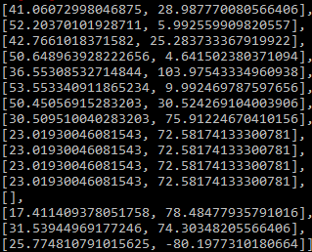
Approach - Geocoding
Unprocessed Data
Processed Data – Latitudes and Longitudes
Bing api

Slide 25
Identifying Time zones

Slide 26
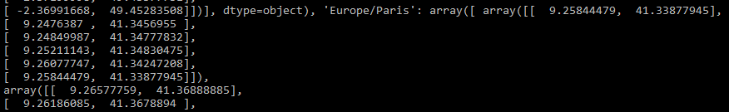

Identifying Time zones - Polygon
Location computed by the api
Location available in the polygon
Europe/Paris

Slide 27
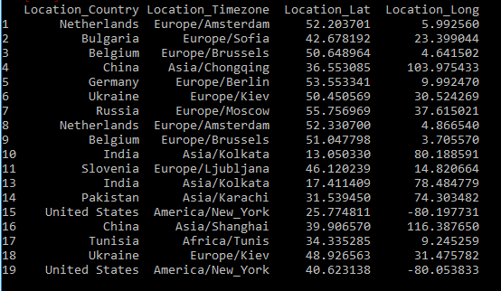
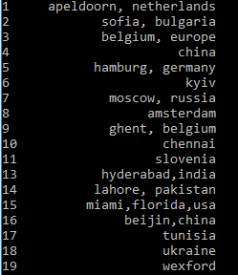
Approach - Identifying Time zones
Sample Data
Processed Data

Slide 28
Identifying post local time

Slide 29
Approach – Identifying Local Time
Latitudes/Longitudes
‘tzwhere’ package
Timezones
‘pytz’ package
Local Time
User Location
‘UTC’ time

Slide 30
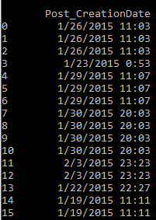
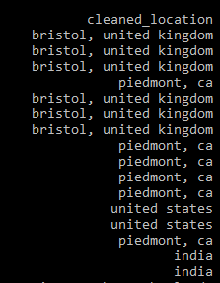
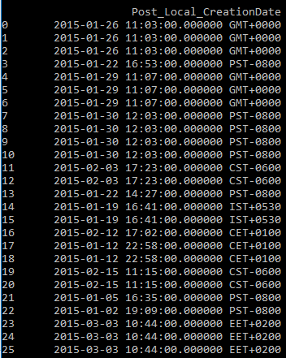
Identifying Local Time
Post creation date
User location
Post local time
geocoder
tzwhere
pytz
Sample Data
Processed Data

Slide 31
Insights & Recommendations
Users from United States have the highest postings in 2015, followed by India, UK, Germany and Canada
Posting activity peaks during Tuesday-Thursday
Weekend activity is less than half of the weekday activity
11 am local time and 3 pm local times have the highest activity
Across the year, there is a drop in activity during May, September and December
Top Tags – Javascript, C++, Java, Android, IOS, PHP, Python
US, India and UK most popular countries for the top/most frequently discussed tags

Slide 32
Insights & Recommendations
Postings trends for any specific geography can be easily drilled down
Popular countries for a specific technology can easily be located.
For a given country, the top technologies/tags can be drilled down easily
For StackOverflow management, this solution can provide targeted marketing based on the technology and geography
For StackOverflow users, this solution can provide insights on the best time of the day for a response, given a query on a specific technology and a geography
For StackOverflow moderators, this solution can provide valuable insights into the posting trends of users and their popularity by geographical regions

Slide 33


